Slide 1

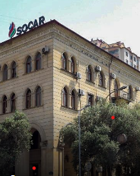
Summer Internship Presentation
Laman Asgarova, Emin Abbasov CE 21.2

Slide 2


founded in 2020
provides cybersecurity solutions
produces network and information security devices (firewall, hotspot, 2FA, etc.) under the national brand "SISLAT"
established in 1995
relational database management system
huge websites like Facebook, Airbnb, GitHub, YouTube, etc. and Content Management Systems like WordPress

Slide 3
SQL Overview
Introduction to SQL
Purpose of SQL in managing databases
Benefits of using SQL in relational databases

Slide 4
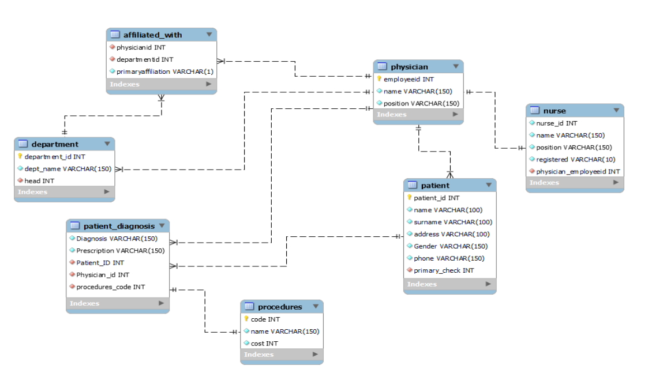
Hospital Management System Database
Designed to streamline and optimize the management of hospital operations.
Here you can see Entity Relationship Diagram
This database contains 7 tables.

Slide 5

Creating the Database
Steps to create database
Writing SQL code for tables and columns
Populating tables with generated data
Ensuring accurate relationships between tables
Data retrieval

Slide 6
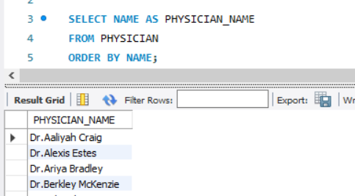
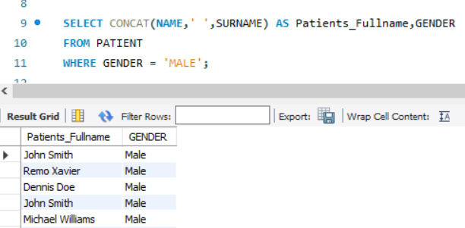
Example Queries
Sorting Physician Names alphabetically:
ORDER BY Clause
Finding all male patients:
WHERE Clause
Creates Condition

Slide 7
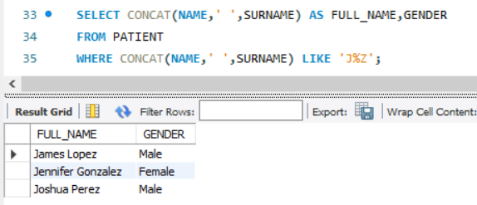
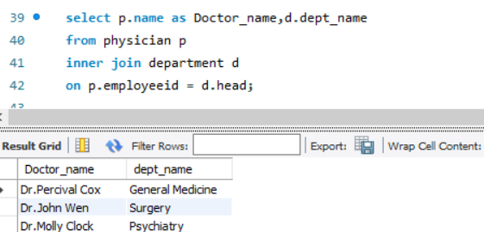
Advanced SQL Queries
Name of the patients starts with J and ends with Z:
LIKE Statement
Name of the physician who the head of each department is also:
INNER JOIN

Slide 8

Conclusion
To conclude, I can state that our internship program, which was conducted in “Cybernetics” LLC, was successfully carried out.
The ER diagram and its associated relational schema show the conceptual and logical designs of the system.
Hospital Management System is for computerizing the working in a hospital.

Slide 9


